Slide 1





DAY3
Aligning PE reads to a reference genome and
BAM refinement
25.11.2015
Chiara Batini
cb334@le.ac.uk
BBASH at

Slide 2
before starting
are you in your scratch directory?
pwd
cd $CINECA_SCRATCH
copy folder day3 from teaching directory to yours
cp –r /pico/scratch/userexternal/cbatini0/day3/ .
cd day3/
ls
The folder VariantCalling contains:
reads in fastq format (in two folders: lane1 and lane2)
reference genome in fasta format (Saccharomyces_cerevisiae.EF4.68.dna.toplevel.fa)
coordinates of the yeast mtDNA (mito.intervals)
the pdf of these slides (day3_mapping_BAM_refinement_nov2015.pdf)
the handbook for today (day3_mapping_BAM_refinement_handbook_nov2015.pdf)

Slide 3
raw reads (.fastq)
1. alignment to a reference genome
close reference?
time limited?
distant reference?
bwa
stampy
aligned reads (.sam/.bam)
2. bam refinement
local realignment
base recalibration
duplicate removal
GATK
GATK
picard
3. bam QC
visualization
duplicate metrics (picard)
flagstat (samtools)
coverage distribution (GATK)
IGV
final alignment (.sam/.bam)

Slide 4
raw reads (.fastq)
1. alignment to a reference genome
close reference?
time limited?
distant reference?
bwa
stampy
aligned reads (.sam/.bam)
2. bam refinement
local realignment
base recalibration
duplicate removal
GATK
GATK
picard
3. bam QC
visualization
duplicate metrics (picard)
flagstat (samtools)
coverage distribution (GATK)
IGV
final alignment (.sam/.bam)

Slide 5
alignment to a reference genome
alignment – process of determining the most likely location within the genome for the observed DNA read
raw reads
reference genome

Slide 6
alignment to a reference genome
short reads: ranging from the initial 36bp of Illumina to the current 1kb of 454/Roche
the shorter the read, the harder is to find its location in the genome
big amount of data: computationally challenging for memory and speed
trade-off: speed vs sensitivity – the higher the accuracy, the longer the alignment run
two classes of methods:
Burrows-Wheeler
Hashing
Fast
less robust at high divergence with reference genome
e.g. bwa
slow (needs more memory)
robust at high divergence with reference genome
e.g. stampy
Further reading: “A survey of sequence alignment algorithms for next-generation sequencing”
Li H. and Homer N. 2010. Briefing In Bioinformatics

Slide 7
alignment to a reference genome – mapping qualities (MQ)
What if there are several possible places to align your sequencing read?
This may be due to:
Repeated elements in the genome
Low complexity sequences
Reference errors and gaps
MQ is a phred-score of the quality of the alignment
With paired-end reads: mapping quality is determined on the pair, thus even if one read can be mapped in several places, the mapping of its pair can help to locate it properly.
raw reads
reference genome
low MQ: the probability of mapping to different locations is high, but no perfect multiple matches
high MQ: a single match
MQ0: a perfect multiple match

Slide 8
SAM/BAM format
SAM – sequence alignment map
BAM – binary alignment map
Standard formats for alignment
BAM is the binary version of SAM – reduced size, easier to store and to access but the full information is not readable by human eye

Slide 9
software websites
software | website
bwa | http://bio-bwa.sourceforge.net/
picard | http://picard.sourceforge.net/
samtools | http://samtools.sourceforge.net/
GATK | http://www.broadinstitute.org/gatk/
tablet | http://bioinf.scri.ac.uk/tablet/
vcftools | http://vcftools.sourceforge.net/

Slide 10
alignment to a reference genome – details
Characteristics of our experiment:
Yeast genome: 12.5 Mbp; 16 chromosomes
Whole genome sequencing
Paired-end reads, 108bp, one library, 2 lanes
You should be in the right directory, otherwise move there
(cd /pico/scratch/userexternal/username/day3)

Slide 11
alignment to a reference genome - indexing
create the index of the reference genome (for bwa, samtools and picard)
bwa index
This is a FM-index – specific to the algorithm behind this aligner
module load bwa
bwa index -a is Saccharomyces_cerevisiae.EF4.68.dna.toplevel.fa
The index file stores records of sequence identifier, length, the offset of the first sequence character in the file, the number of characters per line, and the number of bytes per line.
index .fai
module load autoload samtools
samtools faidx Saccharomyces_cerevisiae.EF4.68.dna.toplevel.fa

Slide 12
alignment to a reference genome - dictionary
create the dictionary of the reference genome (for samtools, gatk and picard)
dictionary .dict
List of contigs included in the fasta file of the reference genome
module load autoload picard
java -jar /cineca/prod/applications/picard/1.119/binary/bin/CreateSequenceDictionary.jar R=Saccharomyces_cerevisiae.EF4.68.dna.toplevel.fa O=Saccharomyces_cerevisiae.EF4.68.dna.toplevel.dict
keep index and dictionary files in the same directory of the reference file

Slide 13
alignment to a reference genome – mapping with bwa mem
From bwa website:
“BWA is a software package for mapping low-divergent sequences against a large reference genome, such as the human genome. It consists of three algorithms: BWA-backtrack, BWA-SW and BWA-MEM. The first algorithm is designed for Illumina sequence reads up to 100bp, while the rest two for longer sequences ranged from 70bp to 1Mbp. BWA-MEM and BWA-SW share similar features such as long-read support and split alignment, but BWA-MEM, which is the latest, is generally recommended for high-quality queries as it is faster and more accurate. BWA-MEM also has better performance than BWA-backtrack for 70-100bp Illumina reads.”
paired-end alignment (per lane)
It uses the reference genome and the reads to create a SAM file
bwa mem -M Saccharomyces_cerevisiae.EF4.68.dna.toplevel.fa lane1/s-7-1.fastq lane1/s-7-2.fastq > lane1.sam
The option –M marks shorter split hits as secondary, and not supplementary (for Picard/GATK compatibility). It changes the flag, so that “old” tools can manage the bam file. A split read is a read which split maps to two different far apart (same or diff chromosome), a chimeric read. This can happen for a read pair too.

Slide 14
alignment to a reference genome – from sam to bam with samtools
sam-to-bam
samtools view -S -b lane1.sam -o lane1.bam
sort the bam (this adds the bam extension automatically!)
It sorts alignments by leftmost coordinates
samtools sort lane1.bam lane1_sorted
index the bam
samtools index lane1_sorted.bam
Can you guess the extension of this file? Check it in your folder... (use unix ls and options)
Can you now repeat this process (paired-end alignment with bwa plus conversion to bam and sorting and indexing) on lane 2?

Slide 15
SAM/BAM format
SAM – sequence alignment map
BAM – binary alignment map
They consist of two parts:
Header – contains information about the sample
Alignment – contains location and qualities for all the reads
Header contains:
@HD – header line; format version
@SQ – Reference sequence dictionary; one per chromosome
@RG – Read group
@PG – Program
@CO – comment

Slide 16
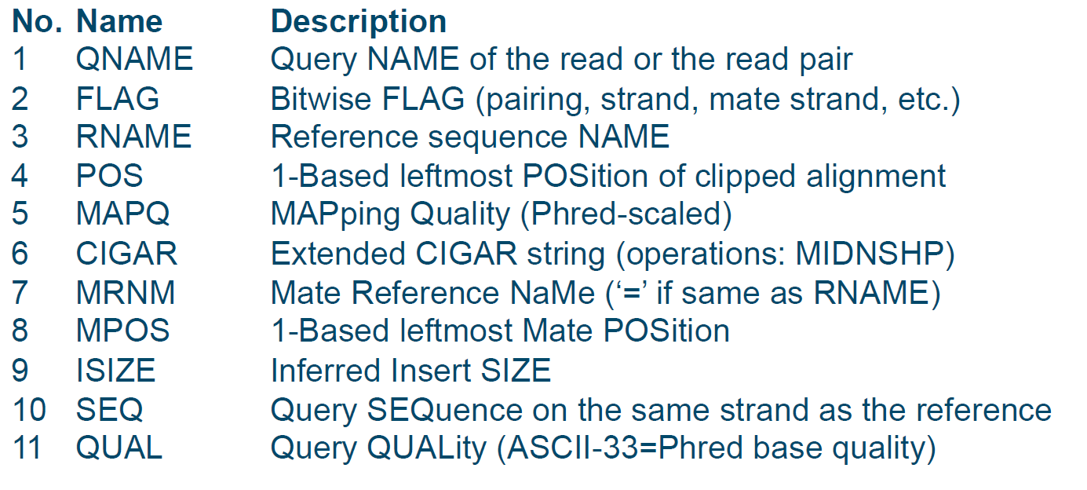
SAM/BAM format
Alignment contains one line per read, and each line contains 12 columns:

Slide 17
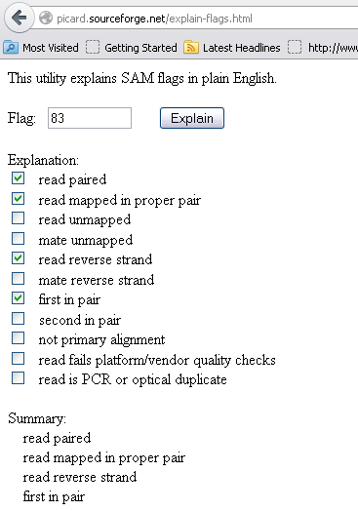
bitwise FLAG
It is an integer, but it represents the sum of different values.
You can find a detailed explanation in the sam/bam format specification (http://samtools.sourceforge.net/SAMv1.pdf).
However there is a tool online which provides a quick “translation” (https://broadinstitute.github.io/picard/explain-flags.html)

Slide 18
CIGAR string
It is a compact representation of sequence alignment. It includes:
M – match or mismatch
I – insertion
D – deletion
SAM extends these to include a few others (check http://samtools.sourceforge.net/SAMv1.pdf)
read: ACGCA–TGCAGT
ref: ACTCAGTG ––GT
cigar 5M1D2M2I2M
So, what is the cigar line of…?
read: ACGTCATG –––CAGT
ref: ACG–CATGCGGCAGT
cigar

Slide 19
CIGAR string
It is a compact representation of sequence alignment. It includes:
M – match or mismatch
I – insertion
D – deletion
SAM extends these to include a few others (check http://samtools.sourceforge.net/SAMv1.pdf)
read: ACGCA–TGCAGT
ref: ACTCAGTG ––GT
cigar 5M1D2M2I2M
So, what is the cigar line of…?
read: ACGTCATG –––CAGT
ref: ACG–CATGCGGCAGT
cigar
3M1I4M3D4M

Slide 20
SAM/BAM format
Which programs have been run on this sam?
Is the read mapped in a proper pair?
Does the read contain any indel compared to the reference genome?
Is the pair on the same chromosome? What is the insert size of the pair?
@HD VN:1.0 SO:coordinate
@SQ SN:chr1 LN:249250621 UR:file:/home/chiara M5:1b22b98cdeb4a9304cb5d48026a85128
@SQ SN:chr2 LN:243199373 UR:file:/home/chiara M5:a0d9851da00400dec1098a9255ac712e
@SQ SN:chr3 LN:198022430 UR:file:/home/chiara M5:641e4338fa8d52a5b781bd2a2c08d3c3
@SQ SN:chr4 LN:191154276 UR:file:/home/chiara M5:23dccd106897542ad87d2765d28a19a1
@SQ SN:chr5 LN:180915260 UR:file:/home/chiara M5:0740173db9ffd264d728f32784845cd7
@SQ SN:chr6 LN:171115067 UR:file:/home/chiara M5:1d3a93a248d92a729ee764823acbbc6b
@SQ SN:chr7 LN:159138663 UR:file:/home/chiara M5:618366e953d6aaad97dbe4777c29375e
@SQ SN:chr8 LN:146364022 UR:file:/home/chiara M5:96f514a9929e410c6651697bded59aec
@SQ SN:chr9 LN:141213431 UR:file:/home/chiara M5:3e273117f15e0a400f01055d9f393768
@SQ SN:chr10 LN:135534747 UR:file:/home/chiara M5:988c28e000e84c26d552359af1ea2e1d
@SQ SN:chr11 LN:135006516 UR:file:/home/chiara M5:98c59049a2df285c76ffb1c6db8f8b96
@SQ SN:chr12 LN:133851895 UR:file:/home/chiara M5:51851ac0e1a115847ad36449b0015864
@SQ SN:chr13 LN:115169878 UR:file:/home/chiara M5:283f8d7892baa81b510a015719ca7b0b
@SQ SN:chr14 LN:107349540 UR:file:/home/chiara M5:98f3cae32b2a2e9524bc19813927542e
@SQ SN:chr15 LN:102531392 UR:file:/home/chiara M5:e5645a794a8238215b2cd77acb95a078
@SQ SN:chr16 LN:90354753 UR:file:/home/chiara M5:fc9b1a7b42b97a864f56b348b06095e6
@SQ SN:chr17 LN:81195210 UR:file:/home/chiara M5:351f64d4f4f9ddd45b35336ad97aa6de
@SQ SN:chr18 LN:78077248 UR:file:/home/chiara M5:b15d4b2d29dde9d3e4f93d1d0f2cbc9c
@SQ SN:chr19 LN:59128983 UR:file:/home/chiara M5:1aacd71f30db8e561810913e0b72636d
@SQ SN:chr20 LN:63025520 UR:file:/home/chiara M5:0dec9660ec1efaaf33281c0d5ea2560f
@SQ SN:chr21 LN:48129895 UR:file:/home/chiara M5:2979a6085bfe28e3ad6f552f361ed74d
@SQ SN:chr22 LN:51304566 UR:file:/home/chiara M5:a718acaa6135fdca8357d5bfe94211dd
@SQ SN:chrX LN:155270560 UR:file:/home/chiara M5:7e0e2e580297b7764e31dbc80c2540dd
@SQ SN:chrY LN:59373566 UR:file:/home/chiara M5:1e86411d73e6f00a10590f976be01623
@SQ SN:chrM LN:16571 UR:file:/home/chiara M5:d2ed829b8a1628d16cbeee88e88e39eb
@RG ID:1 PL:illumina PU:1 LB:1 SM:003_stampy_automasked
@PG ID:GATK IndelRealigner VN:1.2-62-g41ddc7b
@PG ID:stampy VN:1.0.13_(r1160)
@PG ID:GATK TableRecalibration VN:1.2-62-g41ddc7b
@CO TM:Sat, 31 Dec 2011 10:59:43 GMT
HWI-ST427:142:D08WKACXX:6:1202:4868:142425 163 chr1 10002 37 101M = 10075 173 AACCCTAACCCTAACCCTAACCCTAACCCTAACCCTAACCCTAACCCTAACCCTAACCCTAACCCTAACCCTAACCCTAACCCTAACCCTAACCCTAACCC >B<@@B>C<@?>:B>@@BAB@??B<A?9?@@A8>65<B<;?B@@:??B=B@=@?@C9?@90@2?>?@A9=?;*+9*);*0<>AA>C9?@>AC#########

Slide 21
BAM visualization – check the header of your BAM
use samtools to check the header of the BAM
samtools view –H lane1_sorted.bam
How many chromosomes are present in your header?
Which version of the SAM is it?
use unix command more on your SAM file and check what is after the header...

Slide 22
raw reads (.fastq)
1. alignment to a reference genome
close reference?
time limited?
distant reference?
bwa
stampy
aligned reads (.sam/.bam)
2. bam refinement
local realignment
base recalibration
duplicate removal
GATK
GATK
picard
3. bam QC
visualization
duplicate metrics (picard)
flagstat (samtools)
coverage distribution (GATK)
IGV
final alignment (.sam/.bam)

Slide 23
BAM refinement
Input: BAM
Three main steps:
Local realignment
Base quality recalibration
Duplicate removal
Output: BAM
Good practice:
Run step 1 and 2 at lane level, while step 3 must be run at library level

Slide 24
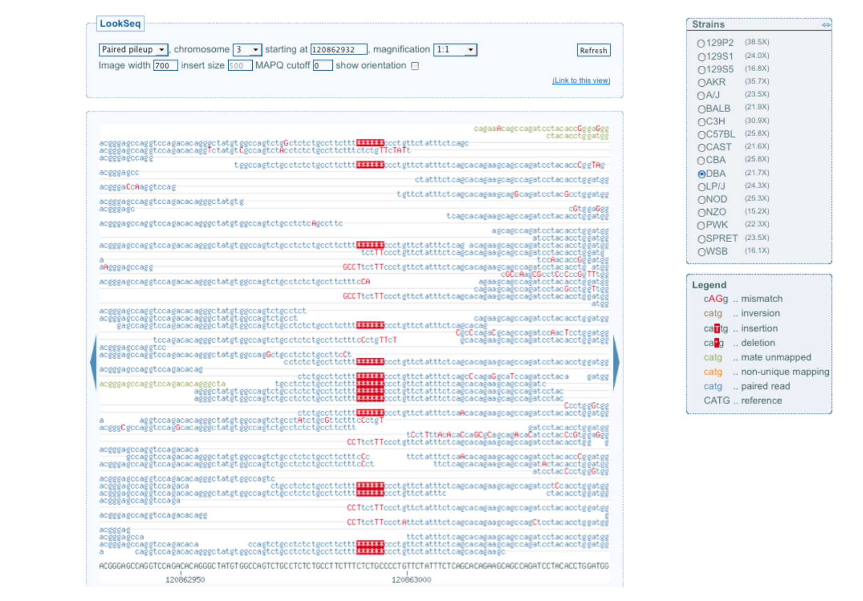
BAM refinement – local realignment
Short indels in the sample relative to the reference sequence can pose difficulties for alignment programs. Indels occuring towards the ends of the reads are often not aligned correctly, introducing an excess of SNPs

Slide 25
BAM refinement – GATK local realignment
It uses the full alignment context to determine whether the indel exists.
Two-step process:
RealignerTargetCreator: it determines the small suspicious intervals which are likely in need of realignment
IndelRealigner: it runs the realignment on those intervals
notes:
having a list of known indels helps
it doesn’t work on 454 reads or from similar technologies (as from GATK webpage)
however I have used on IonTorrent data and it worked fine…

Slide 26
BAM refinement – before starting
merge BAMs per library
java -jar /cineca/prod/applications/picard/1.119/binary/bin/MergeSamFiles.jar INPUT=lane1_sorted.bam INPUT=lane2_sorted.bam OUTPUT=library.bam
GATK wants read groups to be present, and it complains if they are not there. Do we have RG? Check the header…

Slide 27
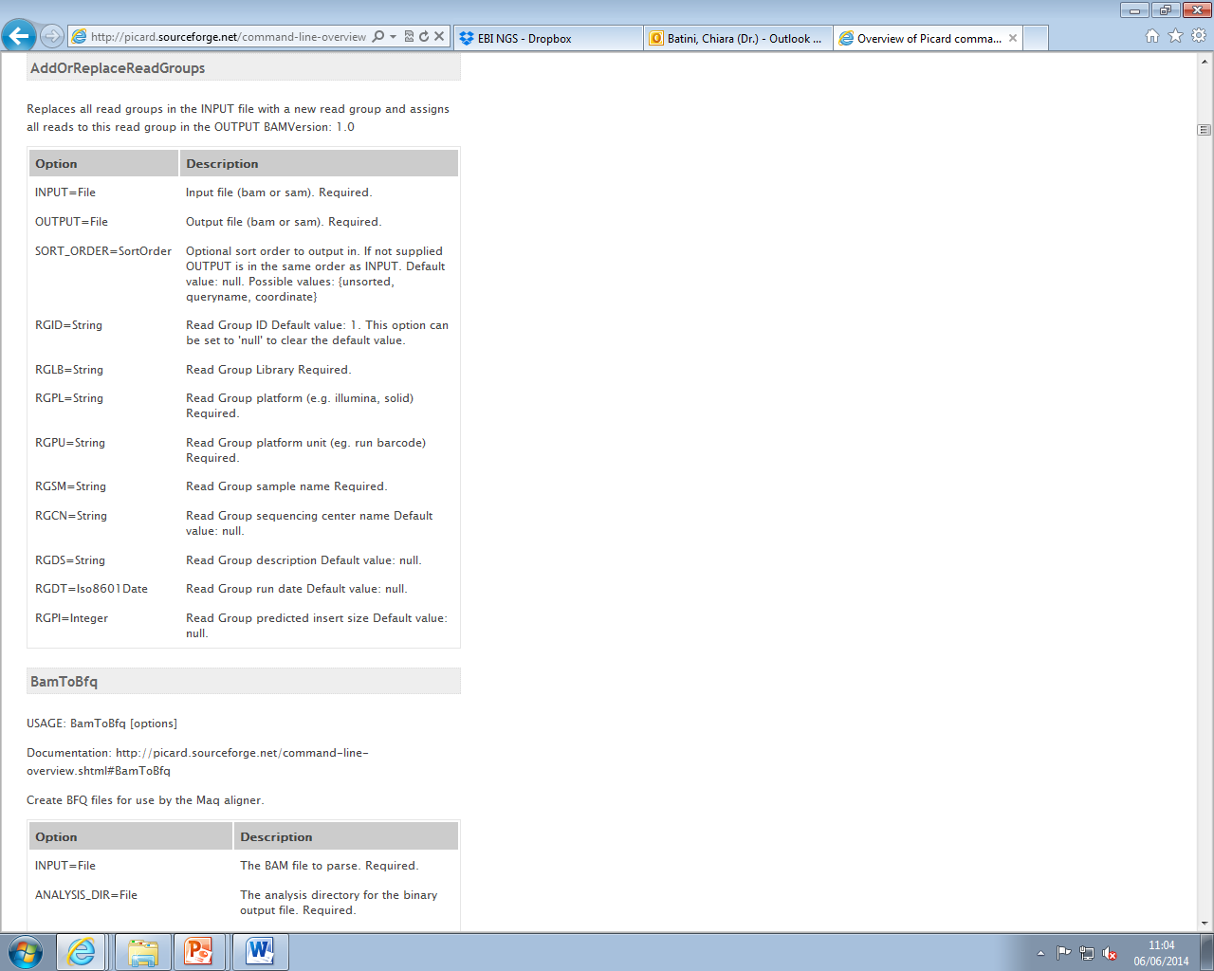
BAM refinement – before starting
In this case we need to add a read group for the library with picard
(please keep in mind that there is a way to do this during the alignment with bwa!)
java -jar /cineca/prod/applications/picard/1.119/binary/bin/AddOrReplaceReadGroups.jar INPUT=library.bam OUTPUT=library_RG.bam RGID=1 RGLB=library RGPL=Illumina RGPU=lane1_2 RGSM=yeast
sort and index the library BAM file with samtools

Slide 28
BAM refinement – local realignment with GATK
module load autoload gatk/3.3.0
1. RealignerTargetCreator:
java -jar /cineca/prod/applications/gatk/3.3.0/jre--1.7.0_72/GenomeAnalysisTK.jar -I library_RG_sorted.bam
-R Saccharomyces_cerevisiae.EF4.68.dna.toplevel.fa
-T RealignerTargetCreator
-o library_targets.intervals
2. IndelRealigner:
java -jar /cineca/prod/applications/gatk/3.3.0/jre--1.7.0_72/GenomeAnalysisTK.jar -I library_RG_sorted.bam
-R Saccharomyces_cerevisiae.EF4.68.dna.toplevel.fa
-T IndelRealigner
-targetIntervals library_targets.intervals
-o library_RG_sorted_lr.bam

Slide 29
BAM refinement – base quality recalibration
Each base call has an associated base call quality (phred-scale).
Rule of thumb: anything less than Q20 is not useful data.
The quality of a call depends on multiple factors (e.g. position in the read, sequence context). In addition, the alignment can provide useful information. Mismatches to the reference are considered errors (unless they are described polymoprhisms).
It supports several platforms: Illumina, SOLiD, 454, Complete Genomics, Pacific Biosciences (stated on the website) and IonTorrent (stated in the GATK forum).
It combines all the available information to re-evaluate the probability of a wrong call at each position in each read.
It requires a catalogue of variable sites!
We will not run it but you can find how to do it at
http://www.broadinstitute.org/gatk/gatkdocs/org_broadinstitute_sting_gatk_walkers_bqsr_BaseRecalibrator.html

Slide 30
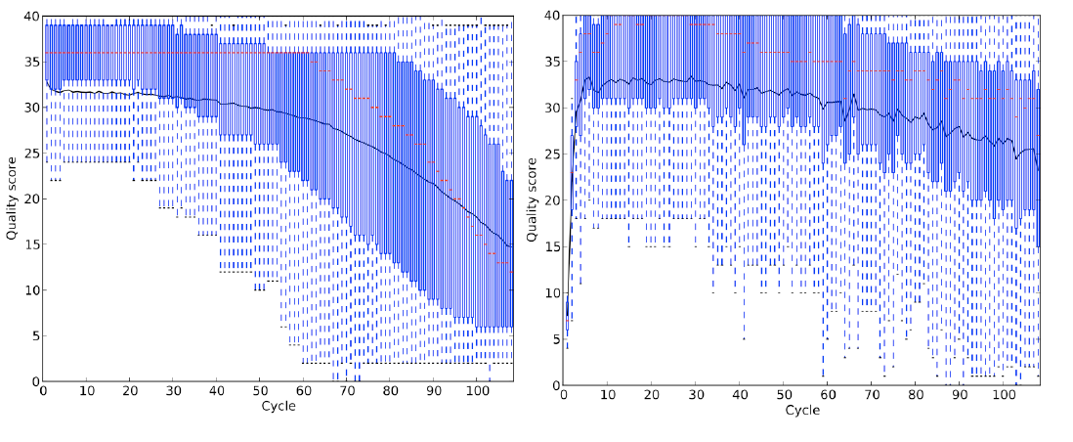
BAM refinement – base quality recalibration

Slide 31
BAM refinement – duplicate removal
PCR is used during library preparation. This can results in duplicate DNA fragments in the final library prep. PCR-free protocols exist but require a large amount of DNA.
It can result in false SNPs calls. Duplicates may fake a high coverage thus giving high support to some variants.

Slide 32
BAM refinement – duplicate removal
Number of duplicates varies according to the complexity of the library: whole genome experiments show lower percentages of duplicates (<5%) than custom enrichment ones (<30%).
It must be done after alignment and at the library level.
It identifies read-pairs where the outer ends map to the same position on the genome and removes all but one copy.
What would you expect in an amplicon-seq experiment?

Slide 33
BAM refinement – duplicate removal
duplicate removal
java -jar /cineca/prod/applications/picard/1.119/binary/bin/MarkDuplicates.jar INPUT=library_RG_sorted_lr.bam OUTPUT=library_final.bam METRICS_FILE=dupl_metrics.txt
sort and index the final BAM with samtools

Slide 34
raw reads (.fastq)
1. alignment to a reference genome
close reference?
time limited?
distant reference?
bwa
stampy
aligned reads (.sam/.bam)
2. bam refinement
local realignment
base recalibration
duplicate removal
GATK
GATK
picard
3. bam QC
visualization
duplicate metrics (picard)
flagstat (samtools)
coverage distribution (GATK)
IGV
final alignment (.sam/.bam)

Slide 35
BAM QC
How many duplicates do I have? Is that reasonable for my experiment?
How many of my reads mapped back to the reference? How many of these are paired in mapping? How many pairs are mapped to different chromosomes?
How much average coverage do I have? Is the coverage evenly distributed along my region?

Slide 36
BAM QC – picard duplicate metrics
java -Xmx2g -jar /cm/shared/apps/picard/1.93/MarkDuplicates.jar INPUT=library_RG_sorted_lr.bam OUTPUT=library_final.bam METRICS_FILE=dupl_metrics.txt
gedit dupl_metrics.txt &
## net.sf.picard.metrics.StringHeader
# net.sf.picard.sam.MarkDuplicates INPUT=[library_RG_sorted_lr.bam] OUTPUT=library_final.bam METRICS_FILE=duple_metrics.txt PROGRAM_RECORD_ID=MarkDuplicates PROGRAM_GROUP_NAME=MarkDuplicates REMOVE_DUPLICATES=false ASSUME_SORTED=false MAX_SEQUENCES_FOR_DISK_READ_ENDS_MAP=50000 MAX_FILE_HANDLES_FOR_READ_ENDS_MAP=8000 SORTING_COLLECTION_SIZE_RATIO=0.25 READ_NAME_REGEX=[a-zA-Z0-9]+:[0-9]:([0-9]+):([0-9]+):([0-9]+).* OPTICAL_DUPLICATE_PIXEL_DISTANCE=100 VERBOSITY=INFO QUIET=false VALIDATION_STRINGENCY=STRICT COMPRESSION_LEVEL=5 MAX_RECORDS_IN_RAM=500000 CREATE_INDEX=false CREATE_MD5_FILE=false
## net.sf.picard.metrics.StringHeader
# Started on: Tue Jan 06 11:00:13 GMT 2015
## METRICS CLASS net.sf.picard.sam.DuplicationMetrics
LIBRARY UNPAIRED_READS_EXAMINED READ_PAIRS_EXAMINED UNMAPPED_READS UNPAIRED_READ_DUPLICATES READ_PAIR_DUPLICATES READ_PAIR_OPTICAL_DUPLICATES PERCENT_DUPLICATION ESTIMATED_LIBRARY_SIZE
library 17741 233562 150769 3152 4668 1187 0.025756 7678471
## HISTOGRAM java.lang.Double
BIN VALUE
1.0 1.005031
2.0 1.979951
3.0 2.925663
4.0 3.843042
5.0 4.732936
6.0 5.596169
7.0 6.433539
8.0 7.245822
9.0 8.03377
10.0 8.79811
It estimates the return on investment (ROI) for sequencing a library to a higher coverage than the observed coverage.
As one increases the amount of sequencing for a library, the ROI for additional sequencing diminishes because more and more of the reads are duplicates.

Slide 37
BAM QC – samtools flagstat
samtools flagstat library_final_sorted.bam > library_flagstat.txt
640134 + 0 in total (QC-passed reads + QC-failed reads)
4500 + 0 secondary
0 + 0 supplementary
12488 + 0 duplicates
489365 + 0 mapped (76.45%:-nan%)
635634 + 0 paired in sequencing
317817 + 0 read1
317817 + 0 read2
452190 + 0 properly paired (71.14%:-nan%)
467124 + 0 with itself and mate mapped
17741 + 0 singletons (2.79%:-nan%)
7016 + 0 with mate mapped to a different chr
3557 + 0 with mate mapped to a different chr (mapQ>=5)
QC: platform/vendor quality check
Duplicates: marked as duplicates by picard
Paired in sequencing: but not necessarily in mapping
Properly paired: it is compatible with the expected insert size
With itself and mate mapped: both are mapped
Singletons: only one is mapped
With mate mapped to a different chromosome: …..
Run flagstat on the BAM file before BAM refinement, can you see any difference?

Slide 38
BAM QC - coverage
coverage per position GATK
java -jar /cineca/prod/applications/gatk/3.3.0/jre--1.7.0_72/GenomeAnalysisTK.jar -T DepthOfCoverage
-R Saccharomyces_cerevisiae.EF4.68.dna.toplevel.fa
-I library_final_sorted.bam
-o mito_coverage
-L mito.intervals
average coverage
gedit mito_coverage.sample_summary &
sample_id total mean granular_third_quartile granular_median granular_first_quartile %_bases_above_15
yeast 3094652 36.08 51 39 27 82.7
Total 3094652 36.08 N/A N/A N/A

Slide 39
BAM QC - coverage
Plot coverage in R
more mito_coverage (have a look at the file before you start R)
module load r
R
data <- read.table("/pico/scratch/userexternal/cbatini0/day3/mito_coverage", sep="\t", header=T)
names(data)
old_col<-data$Locus
new_col<-gsub("Mito:","",as.character(old_col))
data["pos"]<-new_col
plot(data$pos,data$Depth_for_yeast,type="l")

Slide 40
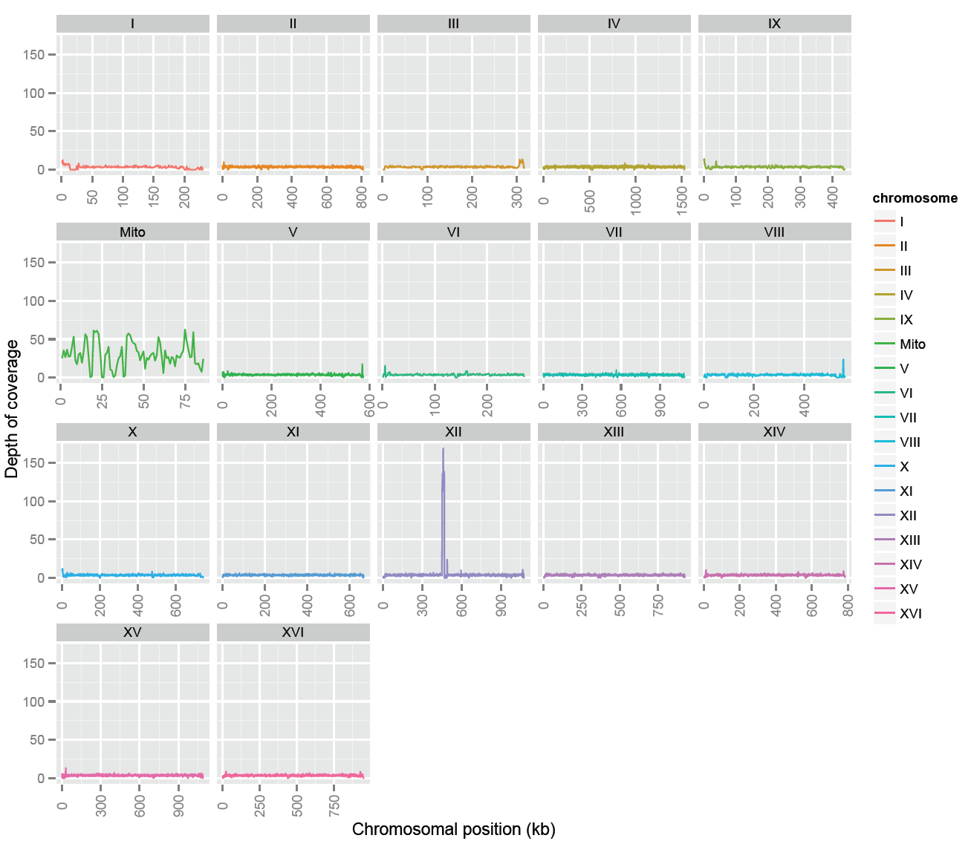
BAM QC - coverage

Slide 41
BAM visualization – IGV
extract mtDNA from final BAM
samtools view –b –o mito.bam library_final_sorted.bam Mito
Launch IGV with Java WebStart
Go to the Download page of IGV, register and launch the 750MB version.

Slide 42
raw reads (.fastq)
1. alignment to a reference genome
close reference?
time limited?
distant reference?
bwa
stampy
aligned reads (.sam/.bam)
2. bam refinement
local realignment
base recalibration
duplicate removal
GATK
GATK
picard
3. bam QC
visualization
duplicate metrics (picard)
flagstat (samtools)
coverage distribution (GATK)
IGV
final alignment (.sam/.bam)

